Slide 1
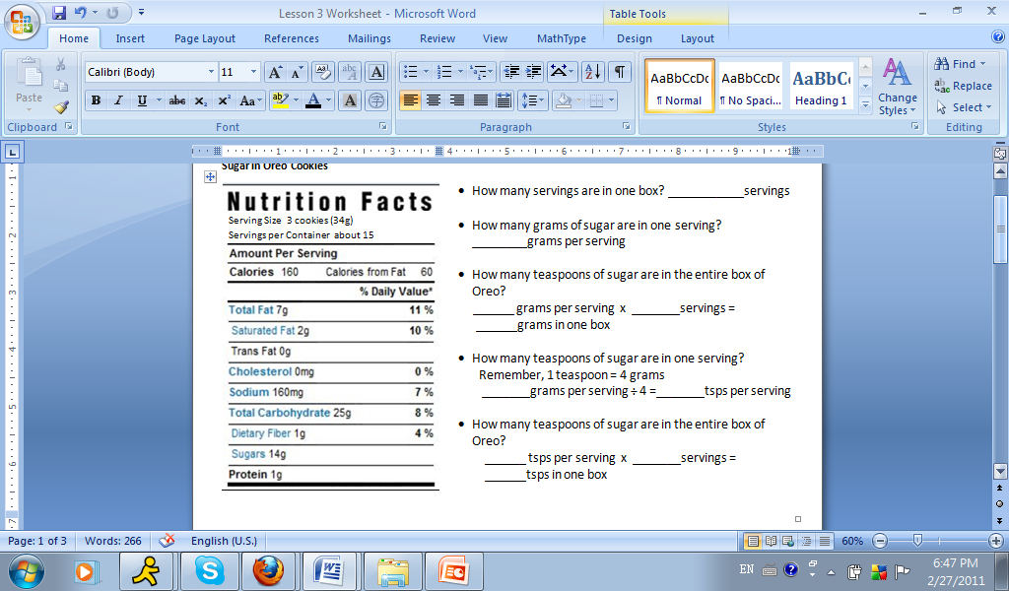
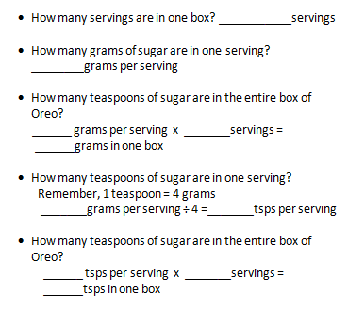
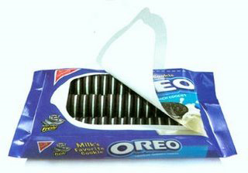
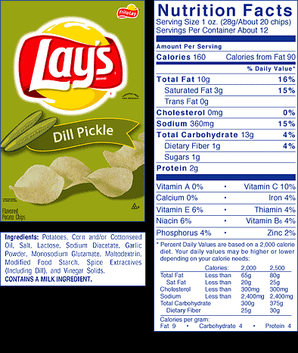
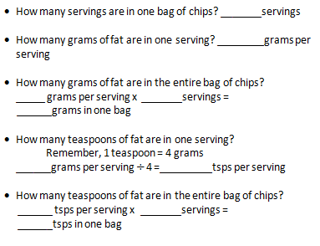
Nutrition Label Worksheet – Lesson 3
Sugar in Oreo
Fat in Chips

Slide 2
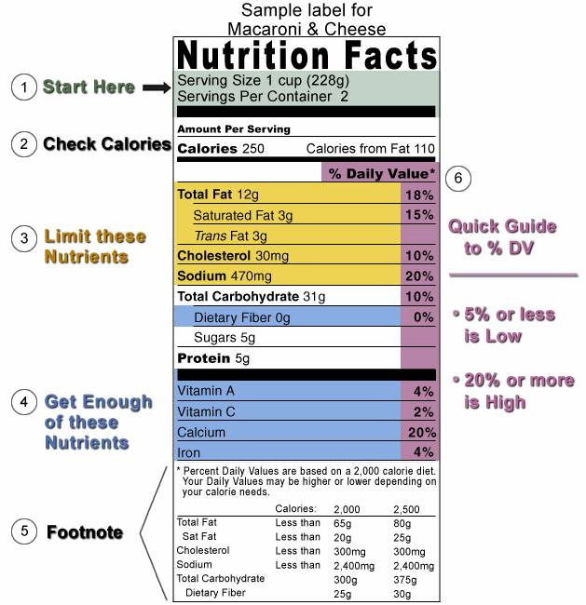
This is an example of how to read the nutrition label of macaroni and cheese. Practice doing the same thing with someone at home with a cereal box!
Quick Guide to how much nutrients this product offers for an adult’s daily need.
5% or less is considered low.
20% or more is high.

